Slide 1
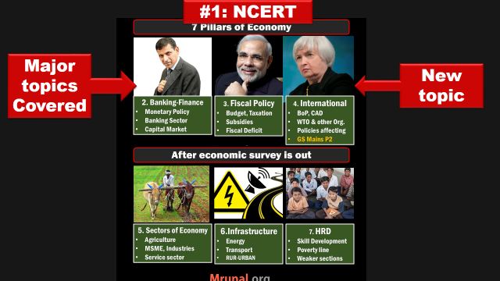

Slide 2
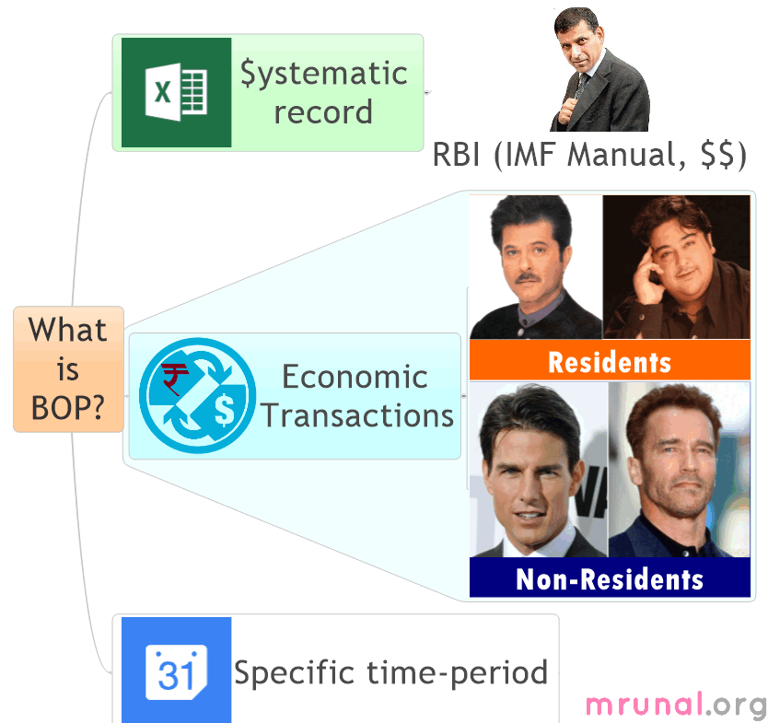

Slide 3
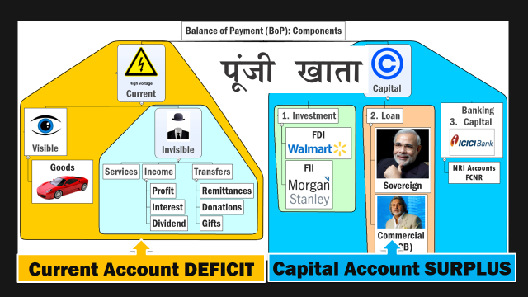

Slide 4
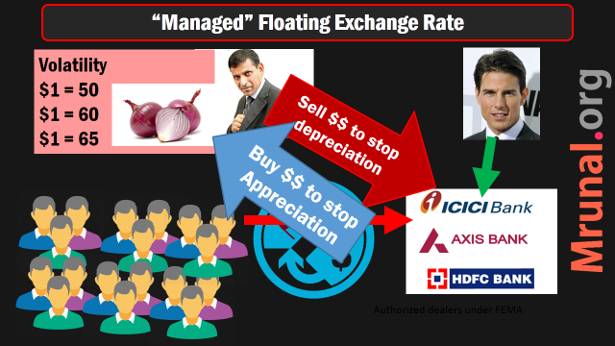

Slide 5
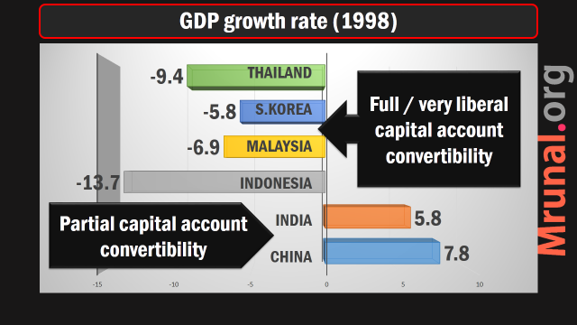

Slide 6
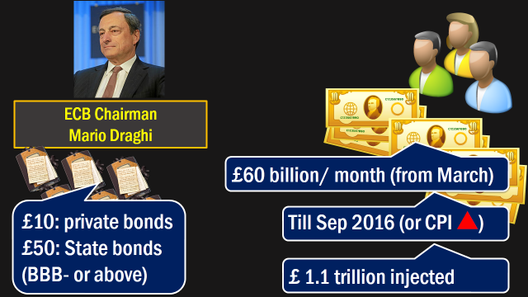

Slide 7
International bodies
IMF- SDR regime
WTO theory & current

Slide 8
Post WW2: cooperation than conflict
Brettonwoods
New Hampshire
USA 1944
World Bank
IMF
GATT
WTO (1995)
Self study
lecture
lecture

Slide 9

Structure
BoD
All nations (188)
FinMin / Gov.
Xo.Board
MD
Annual Meet
IMF

Slide 10
Structure
BoD
All nations (188)
FinMin / Gov.
Xo.Board
Daily work
MD
Annual Meet
24 members:
5 reserved
IMF
USA
UK
Japan
Germany
France

Slide 11
Structure
BoD
All nations (188)
FinMin / Gov.
Xo.Board
Daily work
MD
Washington
+Staff
Annual Meet
24 members:
5 reserved
5 year (reappoint Yes)
IMF

Slide 12
Functions
IMF
Surveillance: global, regional and national.
Help members in BoP crisis, thus help in international trade
Technical assistance, training, advisory role.

Slide 13
Gold standard Currency Exchange system
Features?
Why failed?

Slide 14
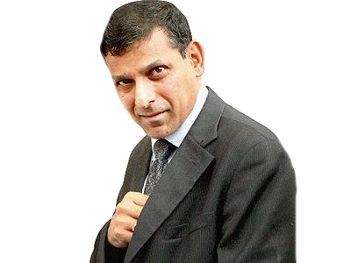
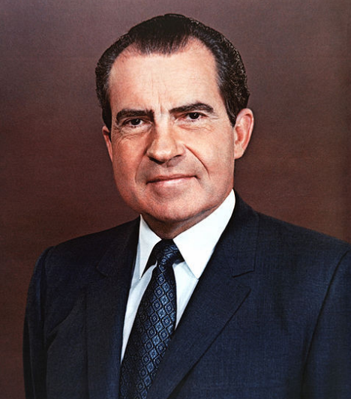


Gold Standad Exchange Rate (upto to 70s)
(+1/-1)% band
1 Rs. = $ 0.30
1 Dollar
Gold pegging
Gold backed
0.30 x 0.88
=0.26 gm
0.88 gms Gold
Notes:
$1 = 0.88gms of Gold
Rs. 1 = 30 US cents = 0.26 gms of gold.
Maintain exchange rate Else central bank has to pump GOLD or US Dollars from its reserve adjust mismatch

Slide 15
Gold backed Exchange Rate (upto 70s)
1 SDR =1 $
1 Rs. = $ 0.30
1 Dollar
0.30 x 0.88
=0.26 gm
Quota contribution
0.88 gms Gold
Notes:
$1 = 0.88gms of Gold
Rs. 1 = 30 US cents = 0.26 gms of gold.
Maintain exchange rate Else central bank has to pump GOLD or US Dollars from its reserve adjust mismatch

Slide 16
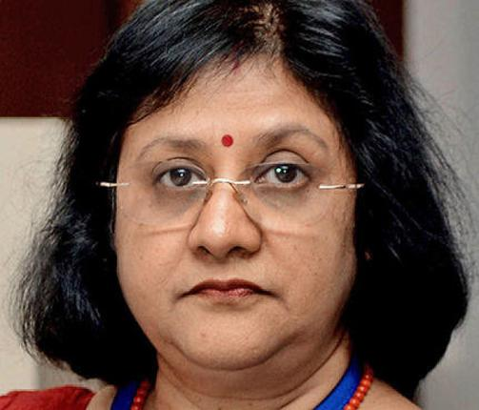
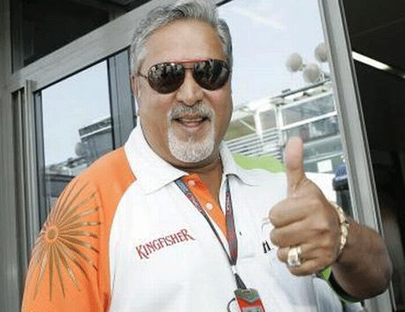
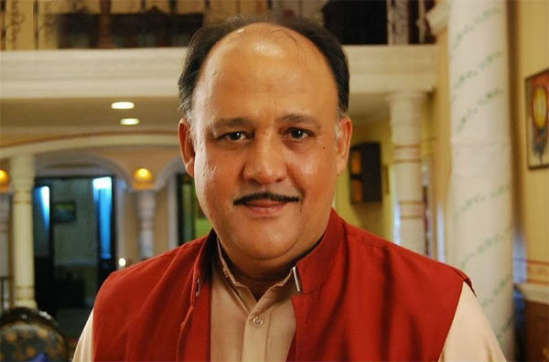


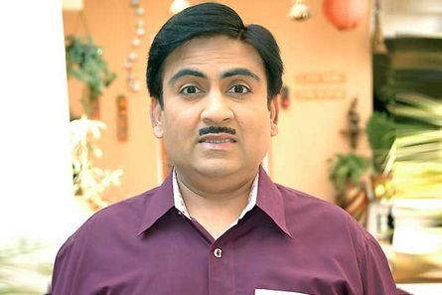
How does Bank work?
Pay 0-4-9%
Pay 10-15-18%
Depositors
Borrowers

Slide 17
IMF SDR
1 SDR =1 $
Depositors
Earn

Slide 18
IMF SDR
Profit Margin
Depositors
Earn
Borrowers
Pay

Slide 19
Cold war years
Arms race
Large subsidies to defense sector
Donations to puppet regimes
Inflation – including gold price

Slide 20

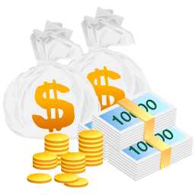
1970s
1 Ounce Gold = $35
Market price 1 oz= >$40

Slide 21
Nixon stops
73: floating exchange
92: India also
1 Ounce Gold = $35
Market price 1 oz= >$40

Slide 22
Meaning
SDR
Also called “Paper gold”
Upto 70s: 1 SDR = 1 US $ =0.88 grams of gold
Present system: 1 SDR = basket of 4 currency ($, Euro, Pound, Yen)
Weight assigned as per their imp. In international trade

Slide 23
SDR: weight assigned to 4 currency
Currency | WT
1. Yen | 9.4
2.Pound | 11.3
3. Euro | 37.4
4. Dollar | 41.9
 | 100

Slide 24
What’s the value of SDR?
Currency | WT | RATE | WT x Rate
yen | 9.4 | 1y=?$
Pound | 11.3 | 1$=?pound
Euro | 37.4 | 1$=Euro
dollar | 41.9 | 1
 | 100 |  | TOTAL
1 SDR = ~1.4 US Dollars

Slide 25
IMF total reserve = SDR
Size of Economy=> Quota
Quota => SDR contribution
SDR contribution => Voting power
SDR Deposit: 0.05% interest rate paid by IMF
SDR Loan: 1.050% interest rate charged by IMF
SDR can be converted to member currency

Slide 26
IMF Quota
BRICS
1/5th World GDP
2/5th Population
Size of economy, GDP, openness to world economy

Slide 27
IMF reforms (Quota)-2010
▲ quota of emerging economies
India: 2.4% (11th) => 2.7% (8th)
China: 4% => 6.4%
by ▼ quota of poor nations
Proposal needs 70% votes, hence pending

Slide 28
IMF Reforms: Governance
BEFORE
POST-2010 Reform
Executive board: 24 directors
Top-5 Quota holders decide 5 / 24 directors
All directors elected
No permanent chairs
Review composition every 8 years
NEED 85% votes….PENDING

Slide 29
IMF
CRITICISM
Surveillance….FAIL
Mexico (1995)
East Asian Crisis (1997)
Subprime crisis, PIGS-crisis, European Sovereign debt crisis…X
SDR interest rate high
Reforms in Quota / governance…X

Slide 30
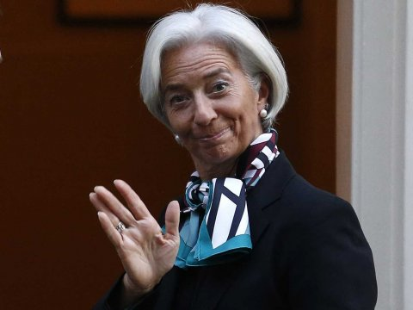
I’ll do belly-dance,
if USA votes in favor of IMF-Reforms
- Christine Lagarde, October, 2014

Slide 31
BRICS vs AIIB: comparison for MCQs
BRICS Bank, Shanghai | AIIB, Beijing
6th summit Fortaleza 2014=>ops.to start from 2016 | AIIB: Asian infra investment bank 2014: MoU signed. start work from ’15. 2014: China+21 member MoU=>2015 starts.
Five members, equal voting power (not in IMF or AIIB.) | China + 21 members. S.Korea, Aussie did not join.
capital: 10 million x 5 members (hence equal voting) | 100 billion capital=>Shareholding based on GDP. Voting power based on shareholding. China:1st, India: 2nd. But, China to dilute shareholding when new members come.
3 function: loan for infra, sus.Development, BoP crisis. | as name suggest: infra. investment projects Structure: Board of governors >> directors >> President (HQ: Beijing)
For BoP crisis: separate contingency reserve: 100 billion. China gave highest. | 2013: Jinping ‘s idea: make profit from forex reserve+ Silkroad finance+ U$ domination reduce.

Slide 32
BRICS bank and AIIB
Asian Infrastructure Investment Bank LINK
BRICS Bank Link

Slide 33
WTO: the origin of,
Bretton Woods
New Hampshire 1944
World Bank
IMF
GATT
Uruguay Round Marrakesh ’94 WTO ’95
Self study
done

Slide 34

GS2: IR-Economy Global grouping-agreements International Bodies: WTO
Structure, function
SPS Agreement
WTO Food subsidy issues
WTO Bali Package
WTO TFA

Slide 35
WTO Structure
Ministerial Conference
Secretariat
General Council

Slide 36
Latest member: Yemen (2014, June)
WTO Structure
Ministerial Conference
Secretariat
General Council
160 MEMBERS
9th @Bali’13
Every 2 yr
Appoint DG
Trade agreements

Slide 37
WTO Structure
Ministerial Conference
DG
General Council
Day2day D/M
Bodies
@Geneva
Trade Policy review
Dispute settlement

Slide 38
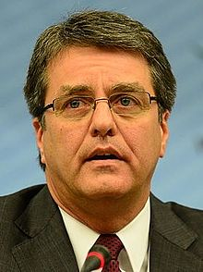
WTO Structure
Ministerial Conference
DG
General Council
4 yrs (reappoint yes)
Secretariat @Geneva
Roberto Azevêdo (Brazil)

Slide 39
Functions
WTO
▼ Barrier to trade:
Tariff
Non-tariff
L.D.C get benefit from world trade
Make agreements to implement 1+2
Dispute settlement if #3s violated
Coop. with others sus.Dvlp, environment

Slide 40
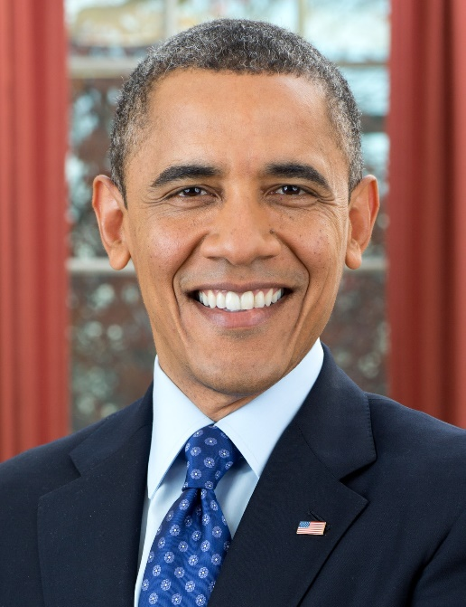

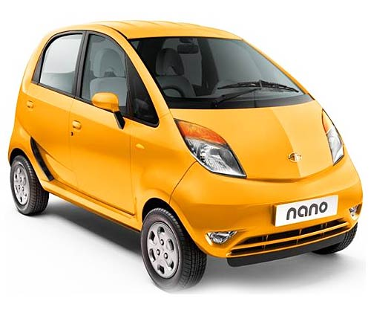
0% Excise duty
36% custom duty
12% CVD
Sales Tax/ VAT / octroi
Tariff Barrier

Slide 41
Red tapes in custom clearance
Quotas for each nation
Non-Tarriff

Slide 42
Subsidies @Detroit
Cheap electricity
Cheap loans
Interest subvention
EPF contribution
Low cost of production
Non-Tarriff

Slide 43
Public procurement
First preference
Deny application
Non-Tarriff

Slide 44
Absurd quality controls
Safety norms
Relaxed norms
Non-Tarriff

Slide 45
Trade Barriers
Tariff
Non Tariff
Subsidies
QUALITY CONTROL
TBT
Public Procurement
SPS
Syllabus
GS2: Policy affecting
GS3: Food processing downstream
Indian Alphonso American poultry
Notes:
Technical barriers to trade
Sanitary, Phytosanitary measures

Slide 46
SPS Agreement
WTO
Sanitary and phytosanitary (SPS) measures
Member can ban import to protect local plant, animal and human lives.
QC must be scientific. FAO-Codex standards can be used
Developing countries be given additional time to comply

Slide 47

EU bans Indian Mango
WTO- SPS
2014, April: EU trade commissioner bans Indian Alphonso, egg plant & other veggies
Reason: fruit fly contamination in earlier shipment (2013).
EU not largest importer but bad publicity

Slide 48
SPS EU-Mango ban
WTO
From April 2014, only APEDA certified Indian mangoes exported
Agricultural and Processed Food Products and Export Development Authority (APEDA)
2015, Jan: finally ban lifted.

Slide 49
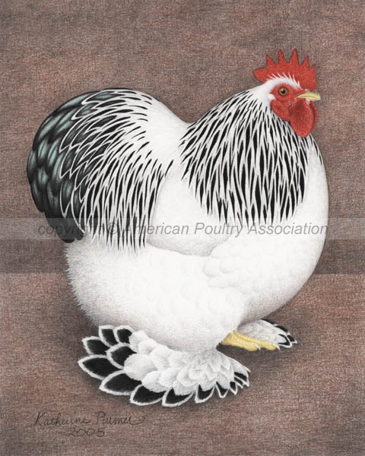
India bans American Poultry
WTO
2007: avian influenza. India bans US poultry import.
But even after that bird flu outbreaks in India.
2012: US challenged ban in WTO
2014: WTO rules in US-favour, because India gave no scientific evidence.

Slide 50
Poultry Interests
WTO-SPS
More US poultry products in Indian market – cheaper
Increased competition for desi players (India 4th largest producer)
2015, Jan: India appealed against this order.

Slide 51
WTO
Trade Barriers
Tariff
Non Tariff
Subsidies
QUALITY CONTROL
TBT
Public Procurement
SPS
Bali Package
TFA
Peace clause
Syllabus
GS2: Policy affecting
GS3: Farm subsidies
Indian Alphonso American poultry
Notes:
Technical barriers to trade
Sanitary, Phytosanitary measures

Slide 52
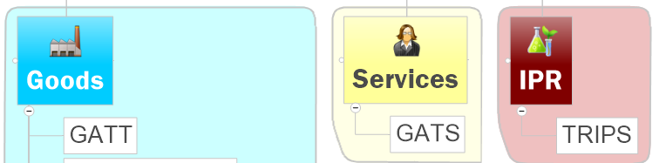
WTO: agreements

Slide 53
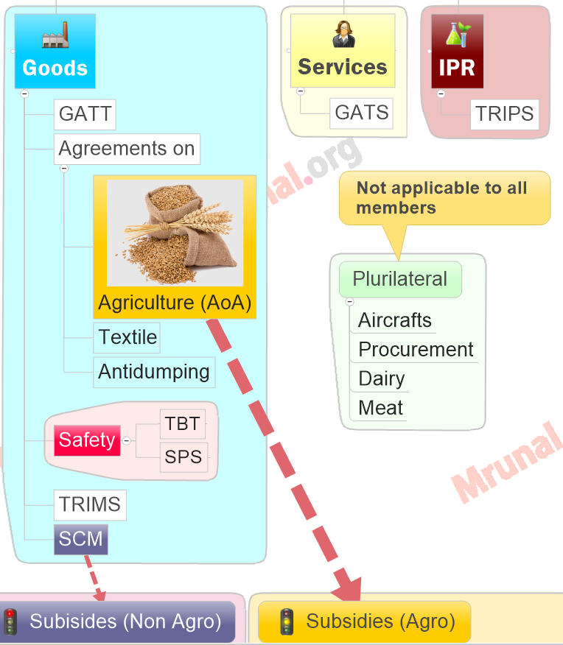
Indian Alphonso American poultry
Food subsidies
Peace-clause, TFA

Slide 54
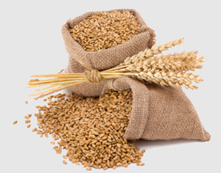
Agreement on Agriculture
WTO-AoA
Three pillars
▼ Import Duty
▼ Export Subsidy
▼ Domestic Subsidy (Amber box)

Slide 55
No
Limits
Subsidies
Green
Amber disruptive
MSP
Fertilizer
R&D, training, pest control
Electricity
Diesel
Blue
Not increase with production
Iceland, Slovenia
5%
10%
No
Limits
Notes:
Technical barriers to trade
Sanitary, Phytosanitary measures

Slide 56
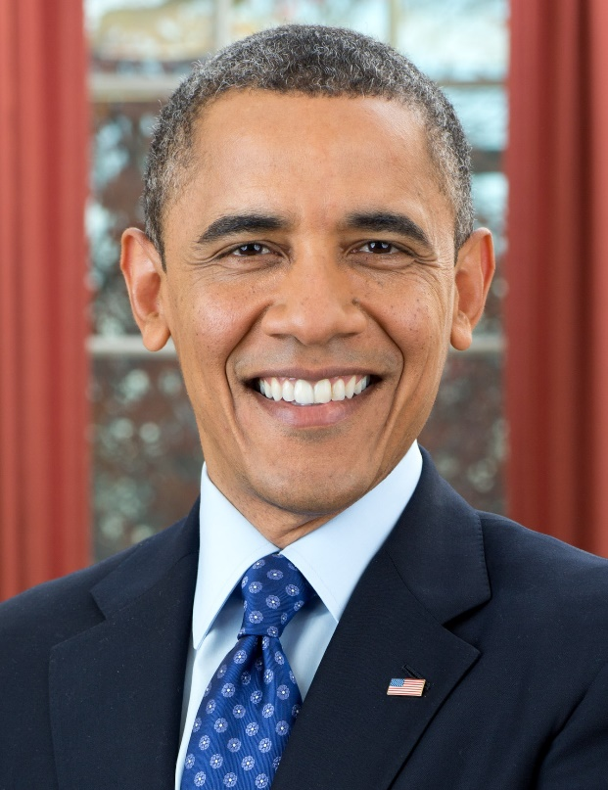
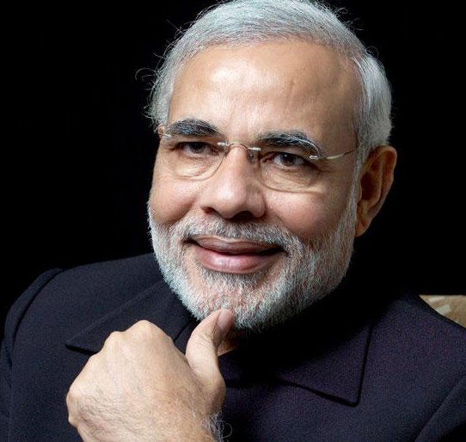
Amber Box: 86-87 production
$100 Billion
De-minimum Level
$10 Billion
5%
10%
$5 billion
$1 Billion

Slide 57
India Opposed because
AoA: 10%
‘86: production low.
US’s 5%>> India’s 10%
Inflation unaccounted
Food security for poors
Income support for farmers

Slide 58
THREE Packages
Bali Summit
9th Ministerial, Bali Indonesia, Dec’13
L.D.C. Duty free quota free market access
Peace Clause
Trade facilitation agreement (TFA)

Slide 59
AoA
Limits
Subsidies
Green
Amber
No limits
Developed (US): 5%
Developing India: 10%
Blue
No Limit
Peace-Clause
WTO won’t hear cases for 4 years (2017)
Permanent solution by 11th Conference
Subsidies only for food security / pub.stockholding
Notes:
Technical barriers to trade
Sanitary, Phytosanitary measures

Slide 60
THREE Packages
Bali Summit
9th Ministerial, Bali Indonesia, Dec’13
L.D.C. Duty free quota free market access
Peace Clause
Trade facilitation agreement (TFA)

Slide 61


Customs Clearance
Trade Facilitation Agreement (TFA)
Bali Summit,
Dec 2013
To be Effective from 2015
BEFORE
AFTER
BENEFIT?
Apply, pay fees/taxes Online
Single window for docu.-check
Faster clearance to perishable goods
No middlemen/agent needed
Coordination bodies @ Nat.+Intl.level
▲$1 Trillion GDP
▲ 21 million jobs

Slide 62
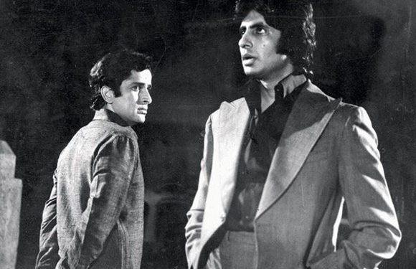
To sign or NOT to sign?
WTO-TFA
Deadline to sign: 31st July 2014
Modi refuses: need permanent solution to food subsidy
Nov’14: Modi Obama deal
Peace clause extended to infinite time till solution reached
India’s food security programs won’t be challenged in WTO
US will back India @WTO

Slide 63
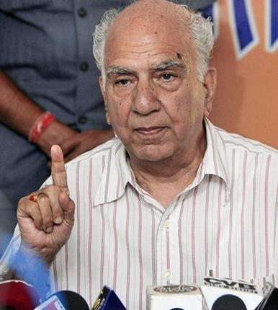
Shanta Kumar (jan. 2015)
FCI-PDS
Reduce subsidy burden
Direct cash transfer to both farmers and poors
NFSA: 67% => Bottom 40%

Slide 64
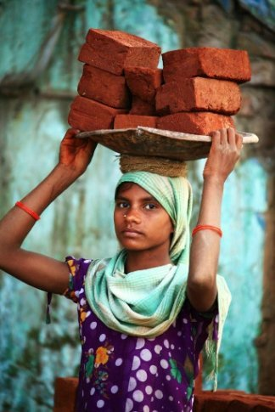
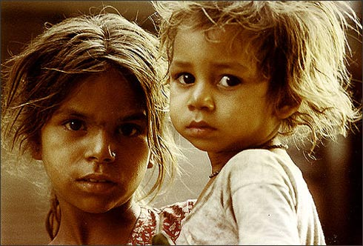

Shanta Kumar on NFSA
Antyodaya
Priority Households
3: rice
2: wheat
1: coarse
50% below MSP
Wheat MSP: 14/kg
Sell @7/kg

Slide 65
Shanta Kumar (jan. 2015)
FCI-PDS
Version#1: deliberately asking to reduce food subsidy, to please USA-WTO & first world
Version#2: Modi unlikely to implement after Delhi Defeat
GS3 farm subsidy-buffer stock: click me

Slide 66
IMF quota reform
WTO: structure, SPS-Mango-Poultry
AoA- Food subsides
Bali summit, Peace clause, TFA

